Slide 1
Healthcare Partners Inc
Check Amount Predictive Model

Slide 2
The Problem Statement
How can the forecasting team at Healthcare Partners predict Administrative Fees forecast (Check Amount) for the next Fiscal Year, with 80% accuracy for its market types: Food, Services, Surgical and Pharmaceuticals, so that the senior leadership can prepare the company budget to present in 3 months.

Slide 3
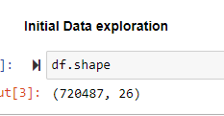
The raw data file - CSV
A data dump from multiple systems.
Cont_Title
Market_Type
Contract_Freq
Fiscal_Earned_Year
Due_Month
Due_Year
Fiscal_Year_Due
Check_Amount
Check_Admin_Amount
Paid_Datekey
Fiscal_Year_Received
Chk_Dt_Deposit
Estimate
Allocation
Accrual_Amount
Allocation_Dt_Start
Allocation_Dt_End
Submission_Id
Submission_Date_Received
Submission_Reported_Adminfees
Submission_Reported_Salesvolume
Category_Desc
Admin_Percent
Cont_Num
Chk_Owner
Previous_Contract_Date

Slide 4
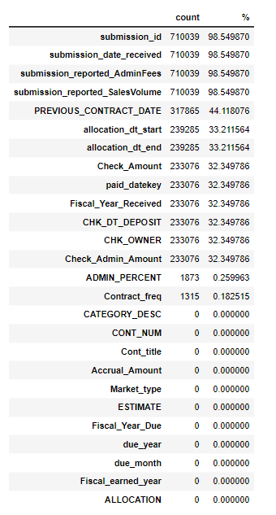
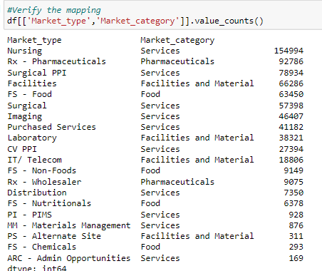
Data Wrangling
Dealing with Missing Values, Redundant Market Types

Slide 5

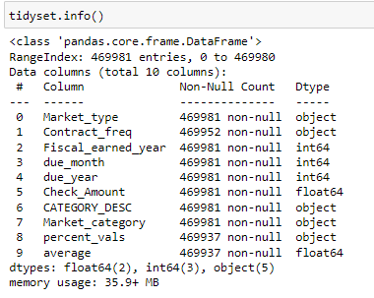
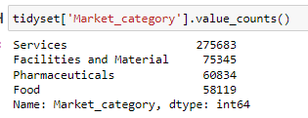
Data Wrangling …
The Tidy data set

Slide 6
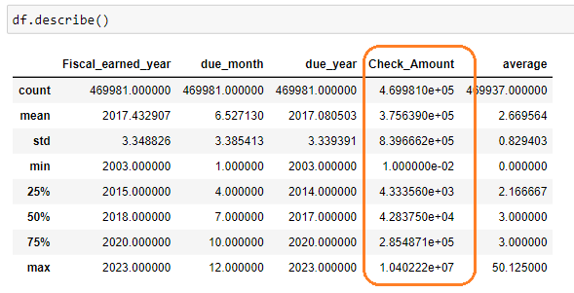
Exploratory Data Analysis - EDA
The process to identify distribution of data, interesting patterns and relationships

Slide 7
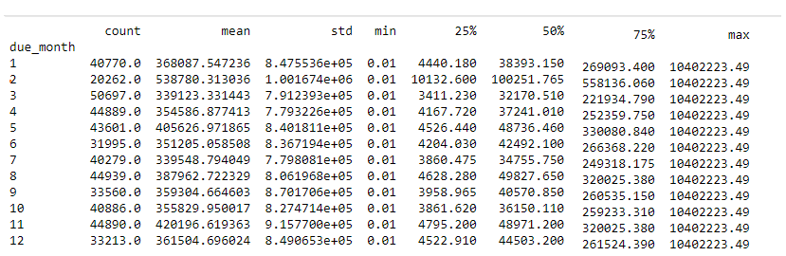
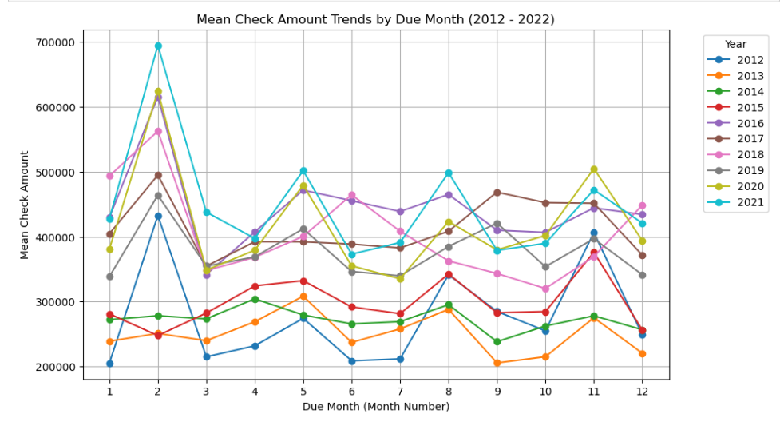
EDA – Explore check amount over the months

Slide 8
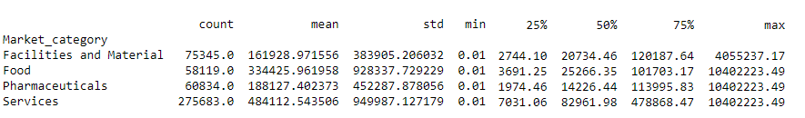
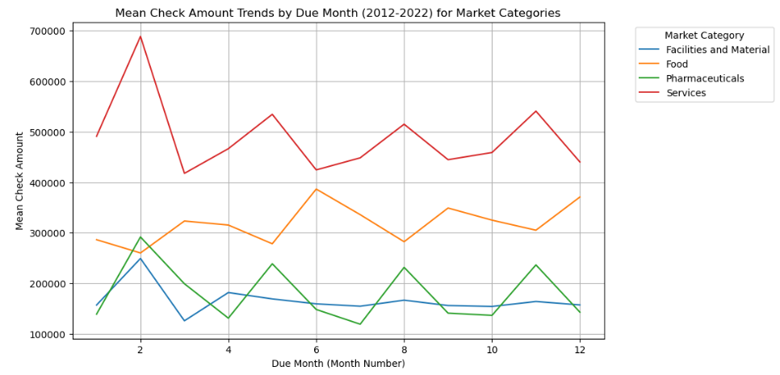
EDA – Explore check amount over different Market Categories

Slide 9
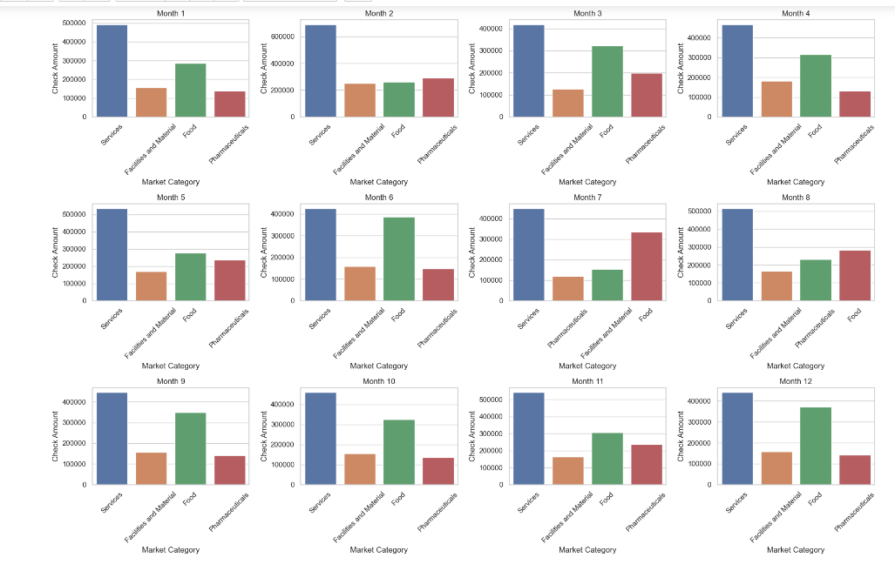
EDA – Explore Due Month and Market Categories

Slide 10
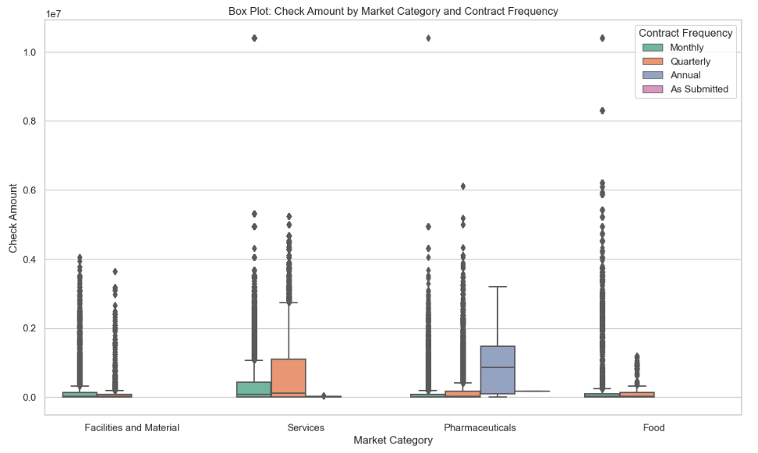
EDA – Data Distribution

Slide 11
Observations / Findings
The most influential feature (predictor) is the Market Category. However, based on the feature important analysis, year and contract frequency which is how often the check payments are received seem highly influential.
Of the various market categories, Services is the biggest contributor.
The contracts that are set up to pay annually has the highest contribution, when compared to contracts that are setup to pay monthly and quarterly.

Slide 12
Modeling
Applied 3 different models
Linear Regression
Random Forest
Gradient Boost Regressor
Comparisons were made after Hyperparameter Tuning

Slide 13
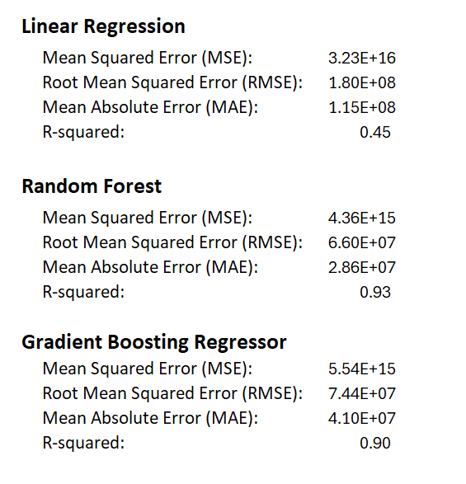
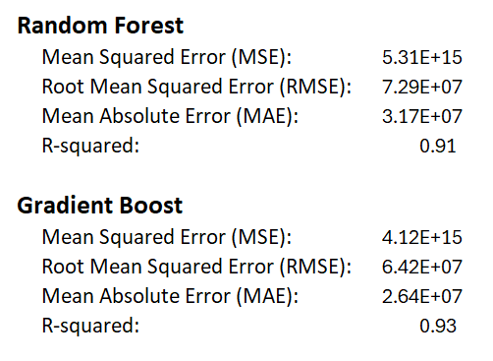
Model Comparison
Standard Models comparison
Hyperparameter - Models comparison

Slide 14
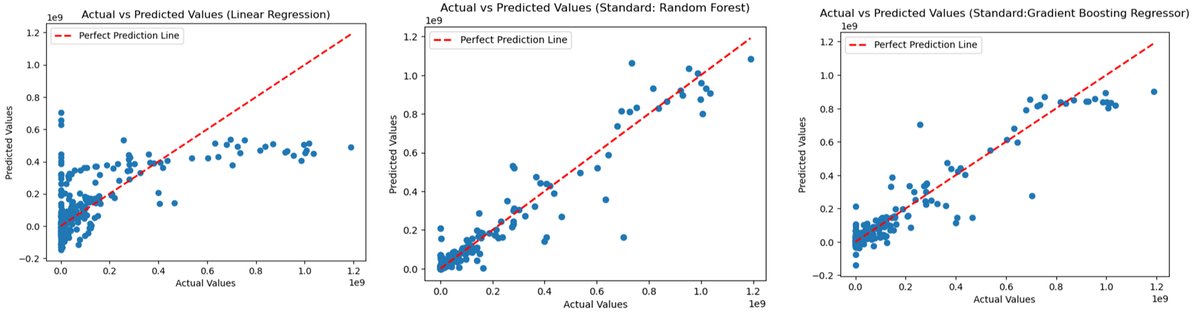
Model Performance – before Hyperparameter Tuning

Slide 15
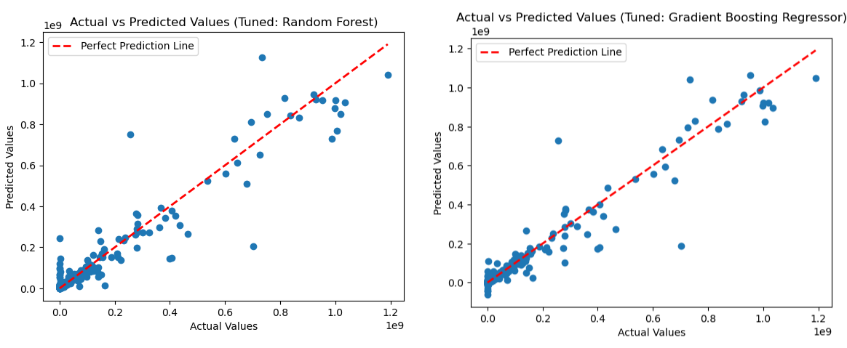
Model Performance – After Hyperparameter Tuning

Slide 16
Future Work
The model performance in my opinion is moderate. I believe the performance can be improved and is proposed as future work.
For the lack of experience and understanding I realized feature engineering was not successfully implemented when training the models.
As future work I suggest feature engineering specifically scaling and imputation to better handle the huge variances that are shown as outliers.
Additionally apply binning on the check amount to see Better and more feature engineering techniques – imputation, scaling, binning and bucketing

